Slide 1
Sentiment Driven Product Recommendation
Hritike Singh Rawat |Varshitha Manjunath
ADVISOR: DR. KHALID ABOALAYON
COURSE: MSDA3999 Fall 2023

Slide 2
Table of Contents
Introduction
Problem Statement
Methodology
Data Collection
Exploratory Data Analysis (EDA)
Statistical/ Machine Learning Results
Results
Challenges
Lessons Learned & Future Work
Conclusion
Acknowledgments
Q&A
References

Slide 3


Introduction
"Your most unhappy customers are your greatest source of learning." - Bill Gates
Ref: Bill Gates book Business @ the Speed of Thought
Let's explore the future of shopping together!"
.

Slide 4
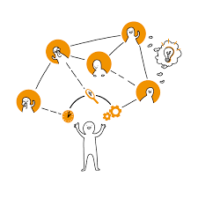
Problem Statement
Overwhelming Shopping Experience:
Conventional shopping experiences, both online and offline, often overwhelm customers with an abundance of choices.
Decision fatigue is a common outcome, leading to dissatisfaction.
Ineffective Recommendation Systems:
Traditional recommendation systems frequently fail to truly understand and cater to the individual needs and sentiments of consumers.
Generic suggestions contribute to a lack of personalization.

Slide 5

Why it’s important
Core of Customer Satisfaction
Missed Business Opportunities
Personalized Interactions
Building Loyalty and Growth
Notes:
Core of Customer Satisfaction:
Customer satisfaction is foundational to the success of any business.
Overcoming the challenges of decision fatigue and dissatisfaction is essential for sustained customer happiness.
Missed Business Opportunities:
A disconnected shopping experience results in missed opportunities for businesses.
Businesses need to adapt to evolving consumer expectations to stay competitive.
Personalized Interactions:
Understanding and addressing customer sentiments enable the creation of personalized, meaningful interactions.
Personalization fosters a sense of connection between customers and businesses.
Building Loyalty and Growth:
Emotional engagement through sentiment-driven approaches builds lasting relationships and fosters customer loyalty.
Ultimately, tapping into customer sentiments is a strategic move for driving business growth.

Slide 6
Methodology: Data Collection
Sources of data: https://www.kaggle.com/datasets/datafiniti/grammar-and-online-product-reviews
Data cleaning and preprocessing steps:
https://colab.research.google.com/drive/1zrby6NsjDkA1ByJn-xMenfnocGejC6Ue?usp=sharing

Slide 7
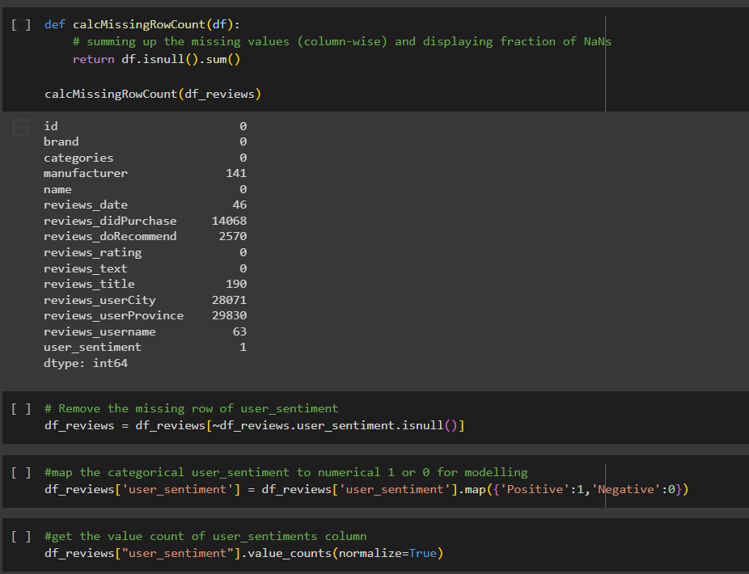
Data Pre-processing:

Slide 8
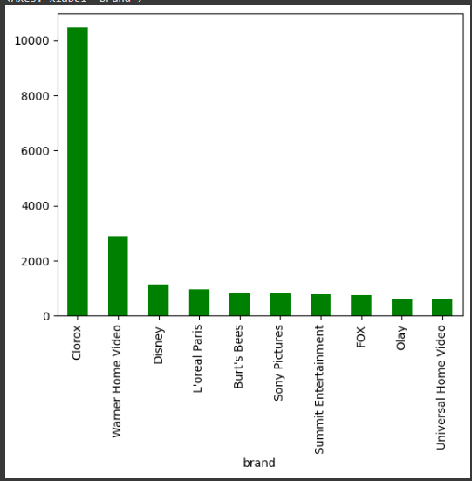
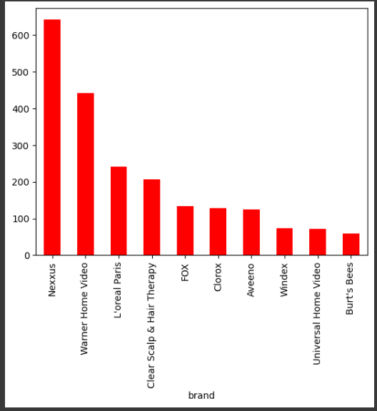
Methodology: Exploratory Data Analysis (EDA)
https://public.tableau.com/views/SentimentBasedProductRecommendation/Dashboard1?:language=en-US&:display_count=n&:origin=viz_share_link
Notes:
Visualizations and key findings from EDA
Any insights gained from the initial exploration
Active dashboard [Tableau]

Slide 9
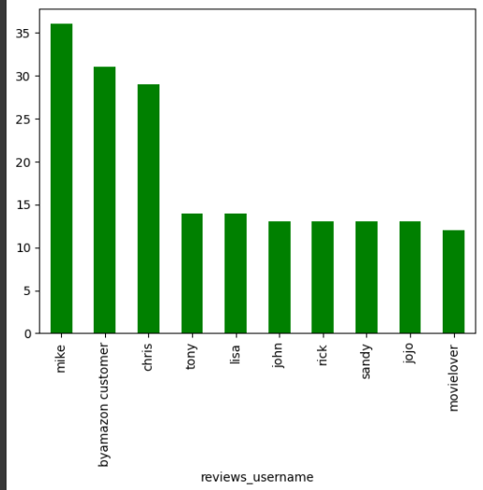
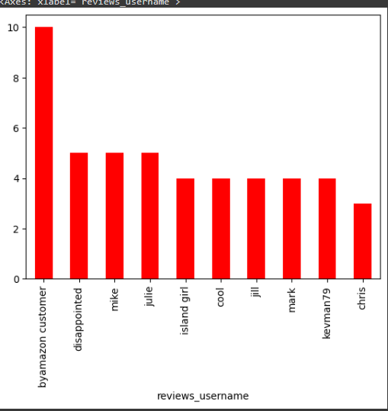
Top 10 users with negative reviews
Top 10 users with positive reviews

Slide 10
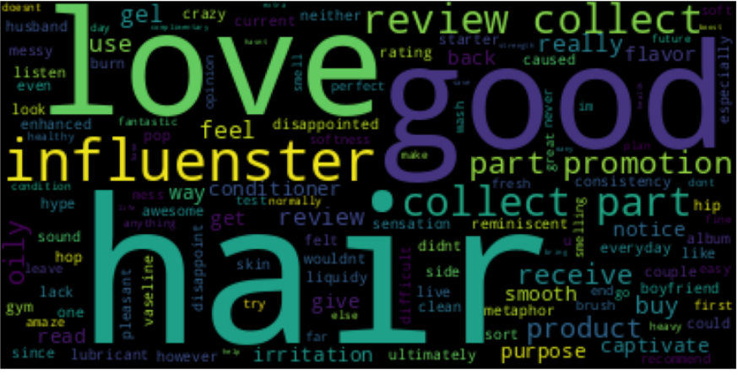
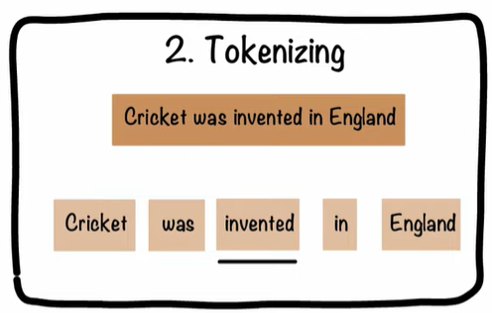
Methodology: Statistical/ Machine Learning
Using a word cloud find the top 40 words by frequency among all the articles after processing the text
Notes:
Describe the statistical or machine learning techniques used
Present key results and findings

Slide 11
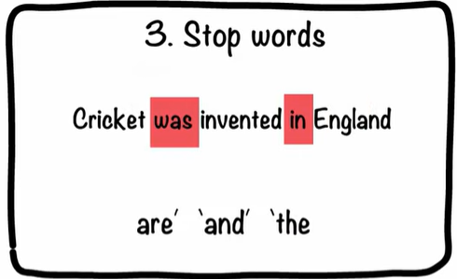
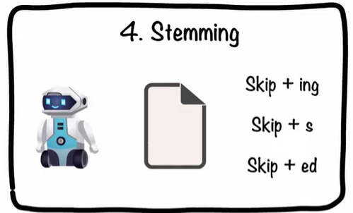
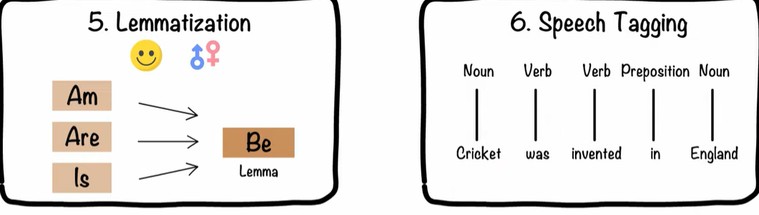

Slide 12
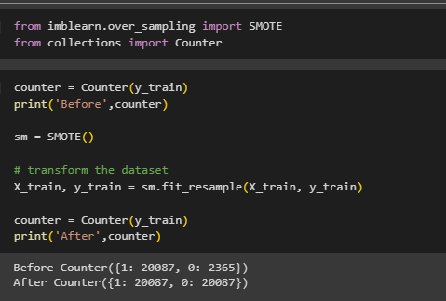
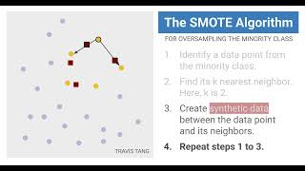
SMOTE Oversampling

Slide 13
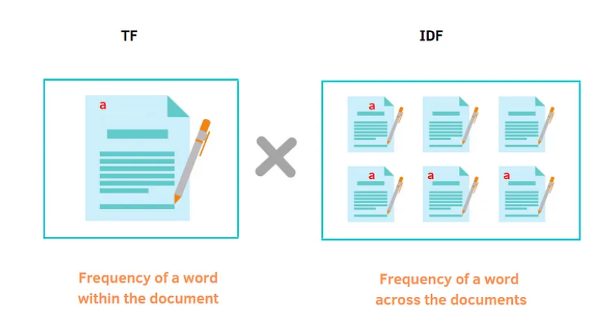
Feature Extraction
using TF-IDF vectorizer using the parameters to get 650 features.
Notes:
TF (Term Frequency) measures how often a word appears in a document. It's like counting how many times a hero shows up in a comic.
IDF (Inverse Document Frequency) tells us how special a word is across all documents. Rare words get a higher score because they're more unique, like a superhero with a one-of-a-kind power.

Slide 14
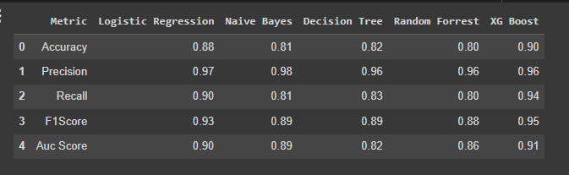
Results
Comparing the above models on the metrics, XG Boost looks to be a better model
Notes:
Showcase any visualizations or key metrics
Highlight the impact of your analysis

Slide 15
Challenges
Data Quality: Finding high-quality sentiment-labeled data was tricky. Sometimes the available datasets had inconsistencies or noisy labels, which could impact the performance of the recommendation system.
Imbalanced Data: The sentiment classes might not have been evenly distributed. For instance, there could be significantly more positive reviews than negative ones, which might bias the recommendation system.
Overcoming: We explored techniques like SMOTE (oversampling) for the minority class or employed class weighting to balance the influence of different sentiment classes during model training. This helped the model learn from the imbalanced data more effectively.
Notes:
Overcoming: I had to carefully preprocess and clean the data, removing duplicates, correcting labels where possible, and using techniques like crowdsourcing for labeling to improve data quality. Additionally, I experimented with various sources and data augmentation methods to enhance the dataset.

Slide 16
Challenges
3. Feature Selection: Determining the right features to capture sentiment and build effective recommendations was a challenge. Some features might be more indicative of sentiment than others, and identifying those was crucial.
Overcoming: We experimented with different feature engineering techniques like TF-IDF, word embeddings, sentiment lexicons, and topic modeling. Conducting thorough analysis and feature importance tests guided us in selecting the most relevant features for sentiment analysis.

Slide 17
challenges
4.Evaluation Metrics: Selecting appropriate metrics to evaluate the recommendation system's performance was crucial. Accuracy alone might not reflect the system's effectiveness in recommending items based on sentiment.
Overcoming: We considered using metrics like precision, recall, F1-score, and area under the ROC curve (AUC-ROC) to evaluate sentiment classification models.

Slide 18
Lessons Learned
Data Quality is Crucial: The project highlighted the paramount importance of high-quality, consistent data in training accurate sentiment analysis models. Cleaning and ensuring the reliability of data significantly impact model performance.
Balancing Act with Imbalanced Data: Dealing with imbalanced sentiment classes necessitated employing specialized techniques like oversampling or class weighting. Understanding and addressing class imbalance improved model robustness.
Feature Engineering is Key: Experimenting with various feature engineering methods underscored the significance of selecting the most relevant features for sentiment analysis. Different features contribute differently to model accuracy.

Slide 19
Future Work
Multi-Modal Sentiment Analysis: Extending the project to incorporate multiple data modalities (text, images, videos) for sentiment analysis could enrich recommendation systems, especially in multimedia content platforms.
Personalized Recommendations: Expanding the recommendation system to provide personalized recommendations based on individual user sentiments or preferences could improve user engagement and satisfaction.
Real-Time Sentiment Analysis: Developing a real-time sentiment analysis component to capture and analyze sentiment as it evolves could be a valuable extension for timely recommendations.

Slide 20
Conclusion
Insights into Sentiment Analysis: Uncovered insights into the complexities of sentiment analysis, including the influence of context on sentiment interpretation and the dynamic nature of feature importance across different sentiment classes.
XGBoost Superiority: Identified XGBoost as a superior model based on the chosen evaluation metrics, showcasing its effectiveness in sentiment prediction and recommendation compared to other models.
Future Directions: Recommended avenues for future research, including exploring nuanced sentiment handling, dynamic data augmentation, and extensions for personalized or multi-modal recommendations to enhance user experiences.
Contributions to Recommendation Systems: Contributed insights and methodologies for building more robust sentiment-based recommendation systems, emphasizing the importance of data quality, feature selection, and model evaluation in such systems.

Slide 21
Acknowledgments
We are deeply grateful for the guidance, expertise, and encouragement provided by Prof.Khald throughout the duration of this project. His insightful advice and support significantly shaped the project's direction and outcomes.
Acknowledgment to the creators and maintainers of Kaggel dataset for making their datasets publicly available. These resources were pivotal in data acquisition and experimentation.
We are thankful to Clark University for providing access to resources, facilities, and research papers that were instrumental in conducting thorough research and analysis.

Slide 22


Slide 23
References
Minqing Hu, & Bing Liu. (2004). Mining and Summarizing Customer Reviews. In Proceedings of the Tenth ACM SIGKDD International Conference on Knowledge Discovery and Data Mining (KDD '04) (pp. 168-177). https://doi.org/10.1145/1014052.1014073
Yifan Hu, Yehuda Koren, & Chris Volinsky. (2008). Collaborative Filtering for Implicit Feedback Datasets. In 2008 Eighth IEEE International Conference on Data Mining (pp. 263-272). IEEE. https://doi.org/10.1109/ICDM.2008.22
Janyce Wiebe, & Rebecca F. Bruce. (2010). A Sentimental Education: Sentiment Analysis Using Subjectivity Summarization Based on Minimum Cuts. In Proceedings of the 48th Annual Meeting of the Association for Computational Linguistics (ACL '10) (pp. 340-348). Association for Computational Linguistics. https://aclanthology.org/P10-1057/
Paolo Cremonesi, Yehia Elkhatib, & Paolo Papotti. (2010). Content-Based Recommendation Systems. In Recommender Systems Handbook (pp. 73-105). Content-based Recommender Systems: State of the Art and Trends | SpringerLink

Slide 24
THANK YOU

